Slide 1
MLOps for R with Azure Machine Learning
David Smith Cloud Advocate, Microsoft @revodavid
Notes:
Azure Machine Learning service (Azure ML) is Microsoft’s cloud-based machine learning platform that enables data scientists and their teams to carry out end-to-end machine learning workflows at scale. With Azure ML's new open-source R SDK and R capabilities, you can take advantage of the platform’s enterprise-grade features to train, tune, manage and deploy R-based machine learning models and applications.
In this talk, the attendees will learn how to:
•Carry out ML workflows using the authoring experience of their choice, from no-code to code-first options that include Azure ML’s drag-and-drop visual interface for defining workflows and RStudio Server on the Data Science Instance, a hosted VM workstation, for using the Azure ML R SDK from the RStudio browser-based interface.
•Use the Azure ML R SDK to manage cloud resources and train, hyperparameter tune, and log and visualize metrics for their models at scale on Azure compute.
•Build ML Pipelines in R for defining and orchestrating reusable and reproducible ML workflows.
•Deploy, manage, and monitor their R ML models and applications as web services on Azure Container Instance and Azure Kubernetes Service, with an emphasis on robust DevOps and CI/CD

Slide 2
What is DevOps?
People. Process. Products.
Build& Test
Deploy
DevOps is the union of people, process, and products to enable continuous delivery of value to your end users.
“
Continuous Delivery
Develop
Operate
”
Donovan Brown, Microsoft
http://bit.ly/WhatIs-DevOps
Plan & Track
Monitor & Learn
Notes:
DevOps is the union of people, process and products to enable the continuous delivery of value to your end customers

Slide 3




DevOps Process
1
4
Plan
Monitor + Learn
Development
Production
2
3
Develop + Test
Release
Notes:
DEVOPS PROCESS
Development :
Plan
Develop and Test
Production:
3. Release
4. Monitor and LEarn
Let’s contrast this to a good devops process where we plan, develop and test, release to test then production environnments, then monitor what happens in production…
But is DevOps just for software development? The algorithms we spoke about at the start?

Slide 4
Machine Learning Process
Prepare data
Evaluate
Production
Build and train
Notes:
MACHINE LEARNING PROCESS
Prepare data
Evaluate Productions
Build and Train
Let’s talk about the work that happens when creating a predictive model
Usually, there’s some data discovery, transformation, and preparation… some building of a model and training using that data… then an evaluation of the suitability of that model
This is a highly iterative, experimental process that might mean going back to the drawing board many times over, over a long period of time.
When it’s time to actually deploy a model, it’s often similar to the way we used to do software – package it up, and let the developers or operations team deploy it somehow

Slide 5
DEVOPS vs MLOPS
DEVOPS | MLOPS
Manage code (source files) | Manage code (source files) Manage data files, notebooks, Rmd docs
Manage infrastructure (as code) | Manage infrastructure (as code) Manage environments (as code)
Source code control | Source code control Track experiment outcomes Manage data sets
Build executables Builds take hours (mostly) commodity compute | Train models Model training may take weeks or months GPU compute
Manage build versions | Manage model versions Manage reproducible environments
Tests (deterministic) Fix bugs with code | Tests (probabilistic) Fix bugs with code and/or data Model drift / model retraining

Slide 6
Azure Machine Learning service
Set of Azure Cloud Services
Python & R SDKs
That enables you to:
Prepare Data
Build Models
Train Models
Manage Models
Track Experiments
Deploy Models

Slide 7
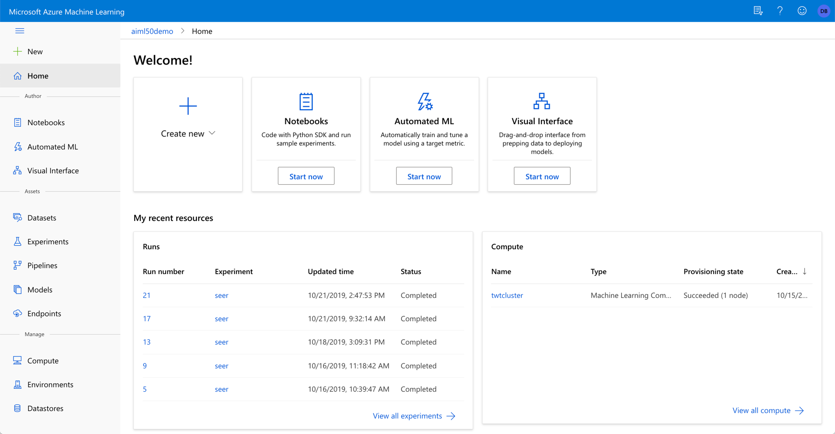
Azure Machine Learning Service: ml.azure.com
Notes:
Azure Machine Learning Service is a set of services for helping your MLOps (or DevOps for ML) efforts.
You can get to it by going to ml.azure.com
Let’s drill into a few of the things it helps you manage

Slide 8
Azure Machine Learning
Datasets – registered, known data sets
Experiments – Training runs
Pipelines – Training workflows
Models – Registered, versioned models
Endpoints:
Real-time Endpoints – Deployed model endpoints
Pipeline Endpoints – Training workflow endpoints
Compute – Managed compute
Environments – defined training and inference environments
Datastores – Connections to data
Notes:
AZURE MACHINE LEARNING
Datasets
Experiments
Pipelines – can include R with RScriptStep
Models
Endpoints
Real-Time Endpoints
Pipeline Endpoints
Compute
Environments
Datastores

Slide 9
Azure ML service SDK for R
Open-source R package for use with CRAN R: azuremlsdk
Create Workspaces, Experiments, Compute, Models, and other artefacts with R commands
Use any R function/package (and track requirements for deployment)
Auto-scaling training clusters (including GPU clusters)
HyperDrive support: smart hyperparameter search with parallel compute
Publish models as web services (in Azure or your own infra)
Trigger training / deployment pipelines from CI/CD services

Slide 10
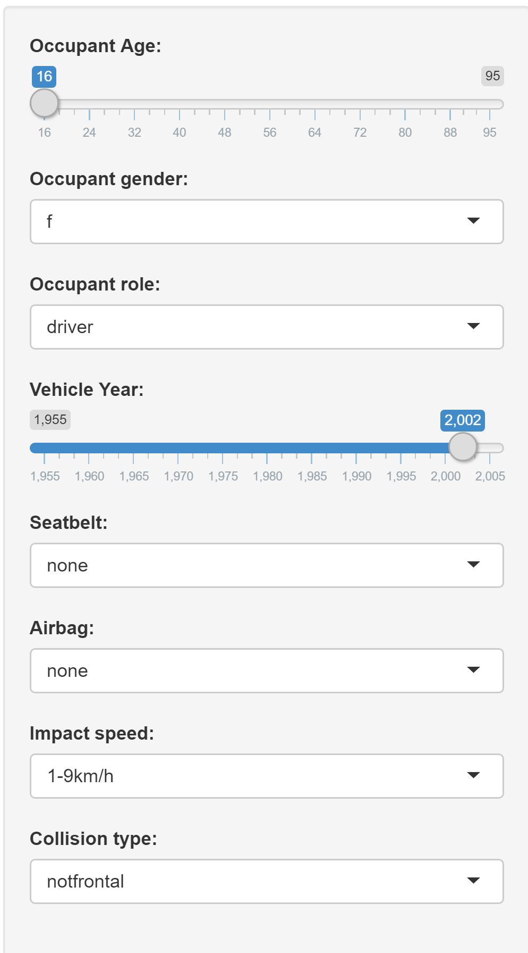
Accident fatality prediction app
Train Model
Create 4-node training cluster
Run experiments: GLM, KNN, GLMNET
Deploy model
Select model by accuracy
Deploy R function as container
Integrate model
Shiny application
Call R function via REST endpoint
Manage Data
Import flat CSV file and clean data
Export to datastore

Slide 11
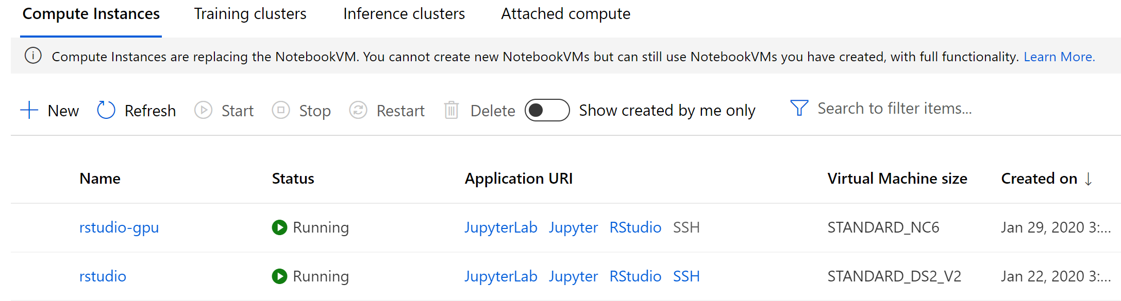
Create compute instance for interactive work
Instances are persistent, charge at usual VM rates … or just use desktop R/Rstudio with azuremlsdk package
… or use your own attached compute server

Slide 12
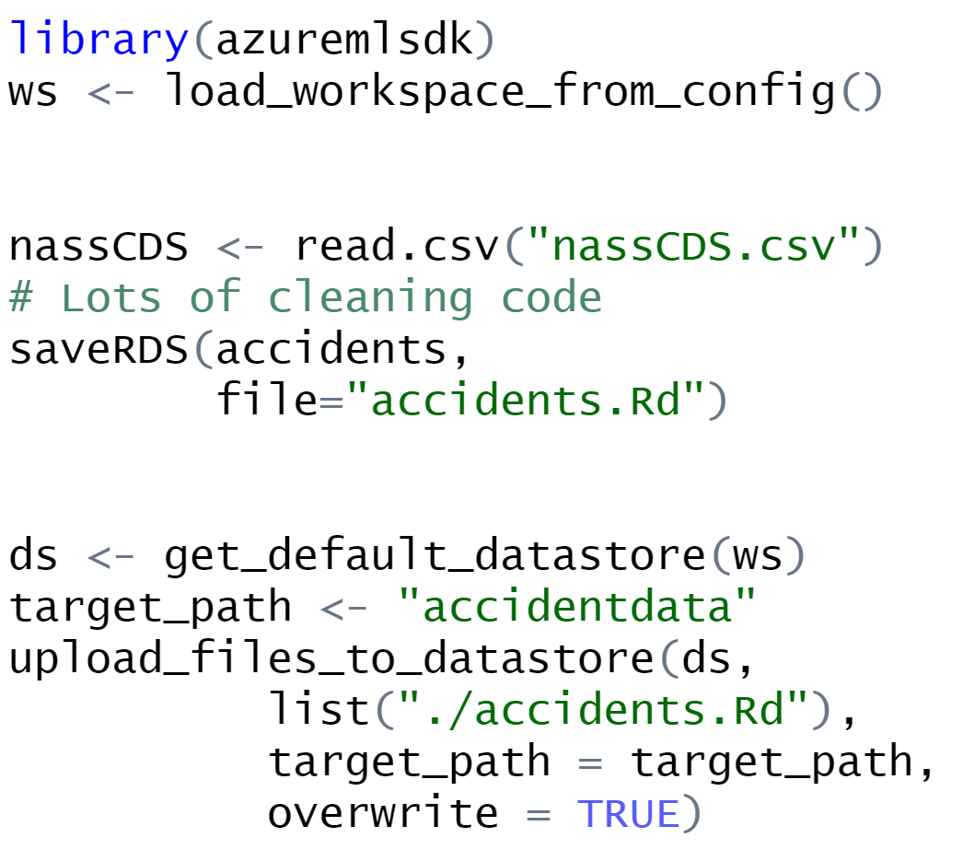
Use Compute Instance to prep and share data
azuremlsdk package and auth keys pre-installed on compute instance Normal R code for data / model experimentation Export data to shared, persistent datastore Can use for files other than data, too

Slide 13
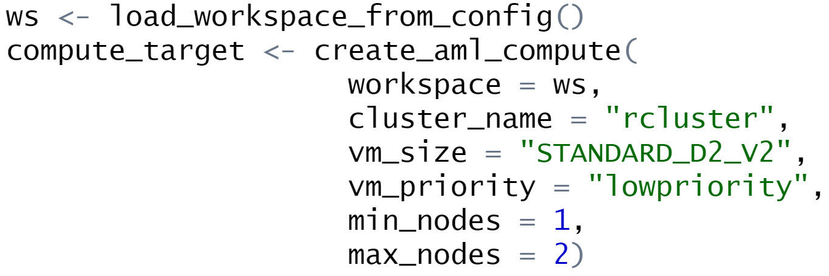
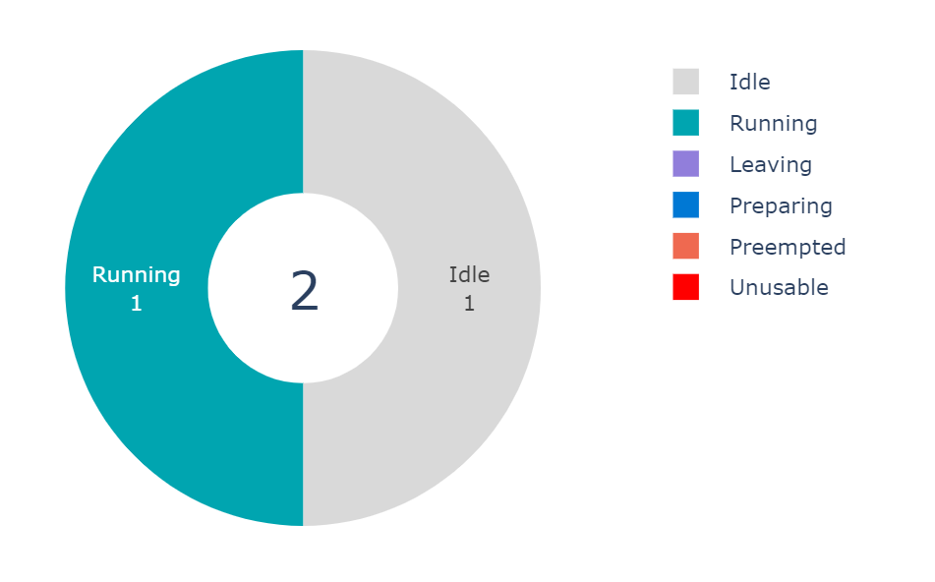
Create 2-node training cluster
Nodes pre-loaded with R and R packages
Scales up as jobs added to queue, scales down when unused
Resize as needed
Shared between workspace users (Python and R)
Low priority nodes for ~80% discount
GPU clusters available

Slide 14
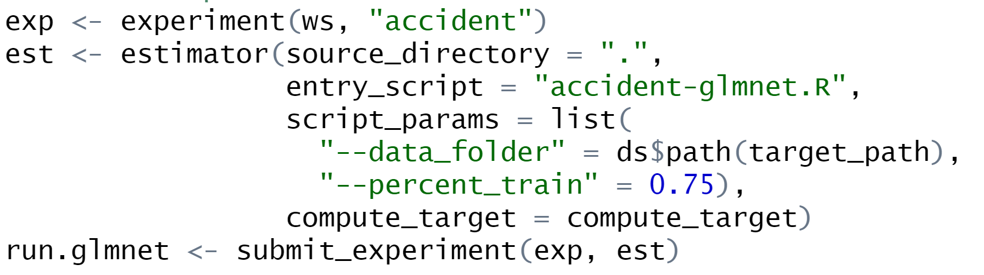
Train models and choose one to deploy
Experiments tracked with source scripts and recorded metrics
Control execution with command line parameters
Most packages pre-loaded, custom packages supported

Slide 15
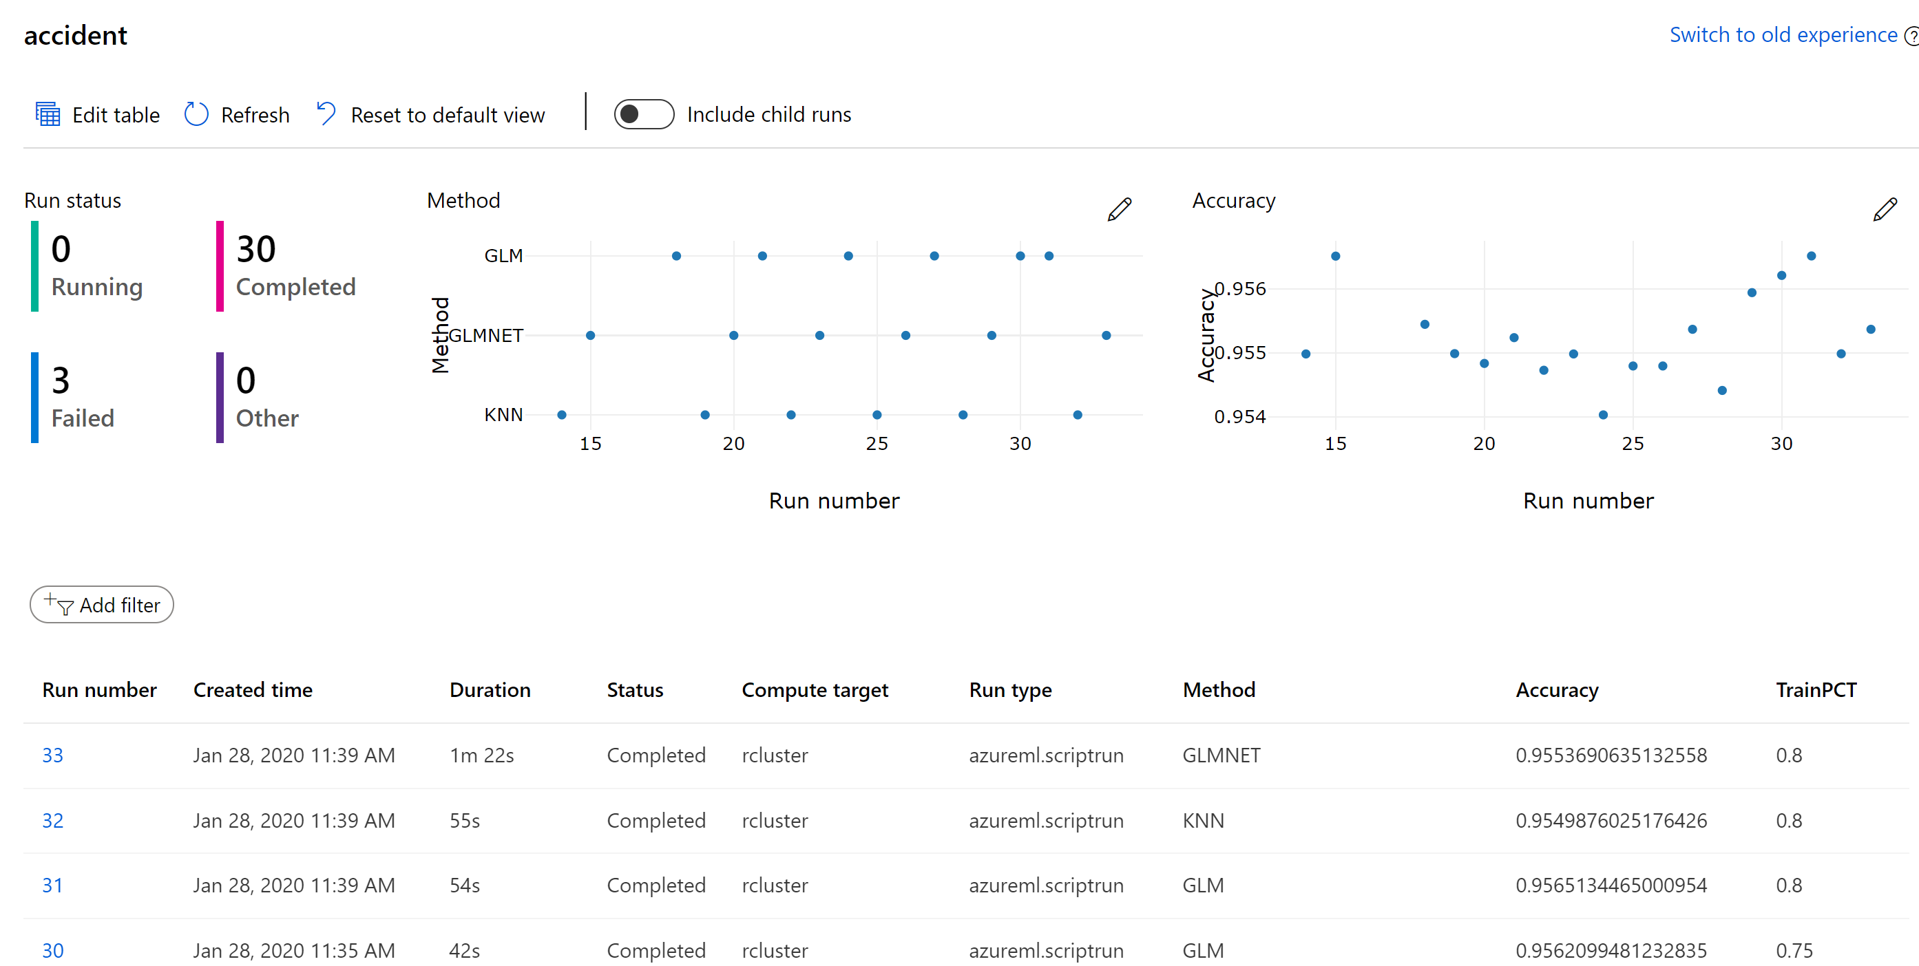

Slide 16
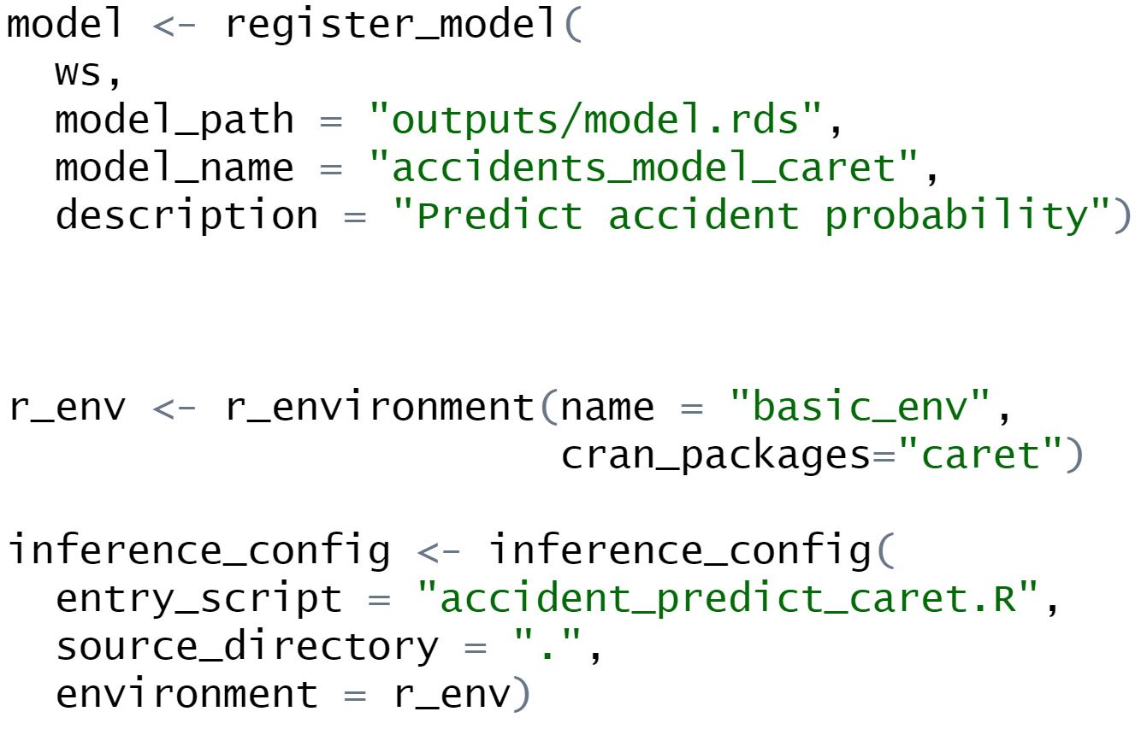
Register model
Register model with R model object
Models can be versioned
Packages (CRAN, GitHub or private) needed to execute.
R script receives model and data (JSON) to make prediction

Slide 17
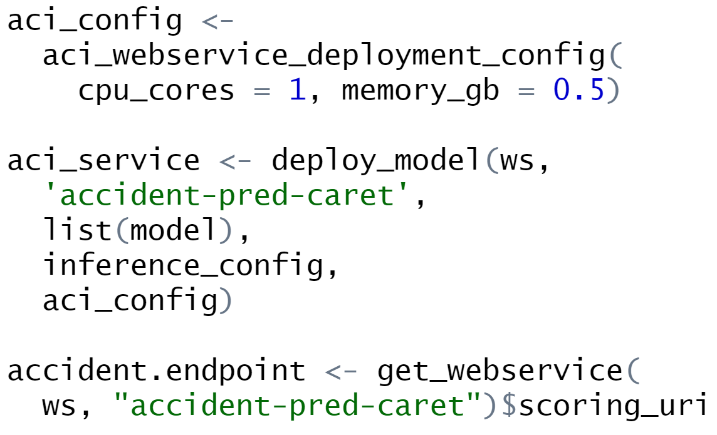
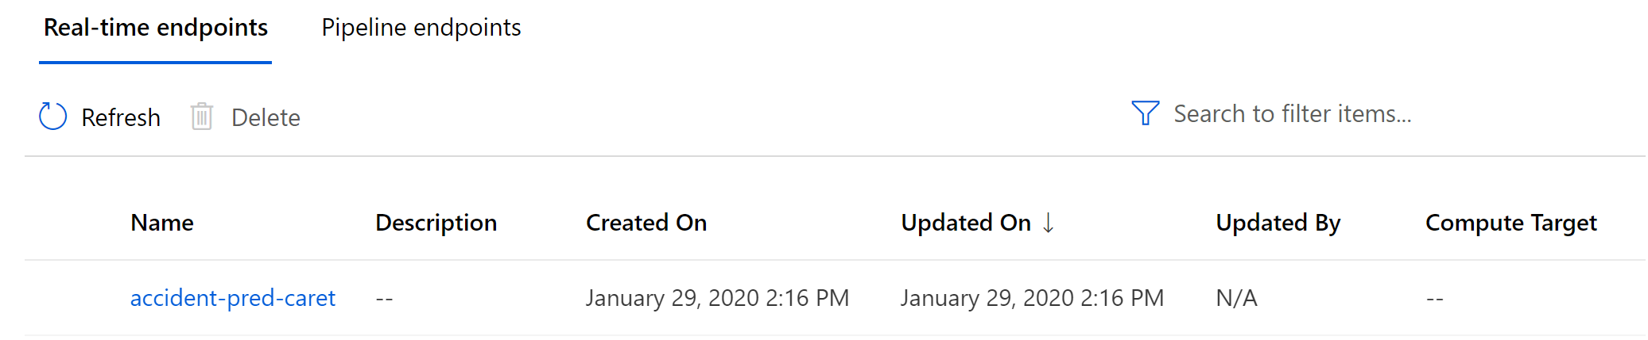
Deploy Model as service
Small container instance for testing
(use Kubernetes for production)
Get REST endpoint for use in app

Slide 18
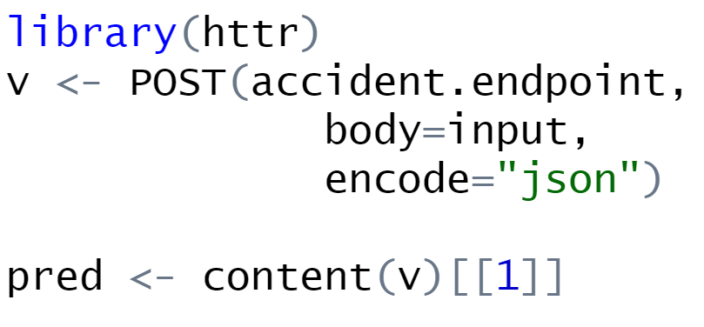
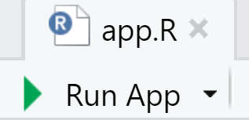
Integrate model into Shiny app
Pass Shiny input data frame to endpoint
Extract prediction from endpoint response
Deploy Shiny app to any server
… or call from any another app

Slide 19
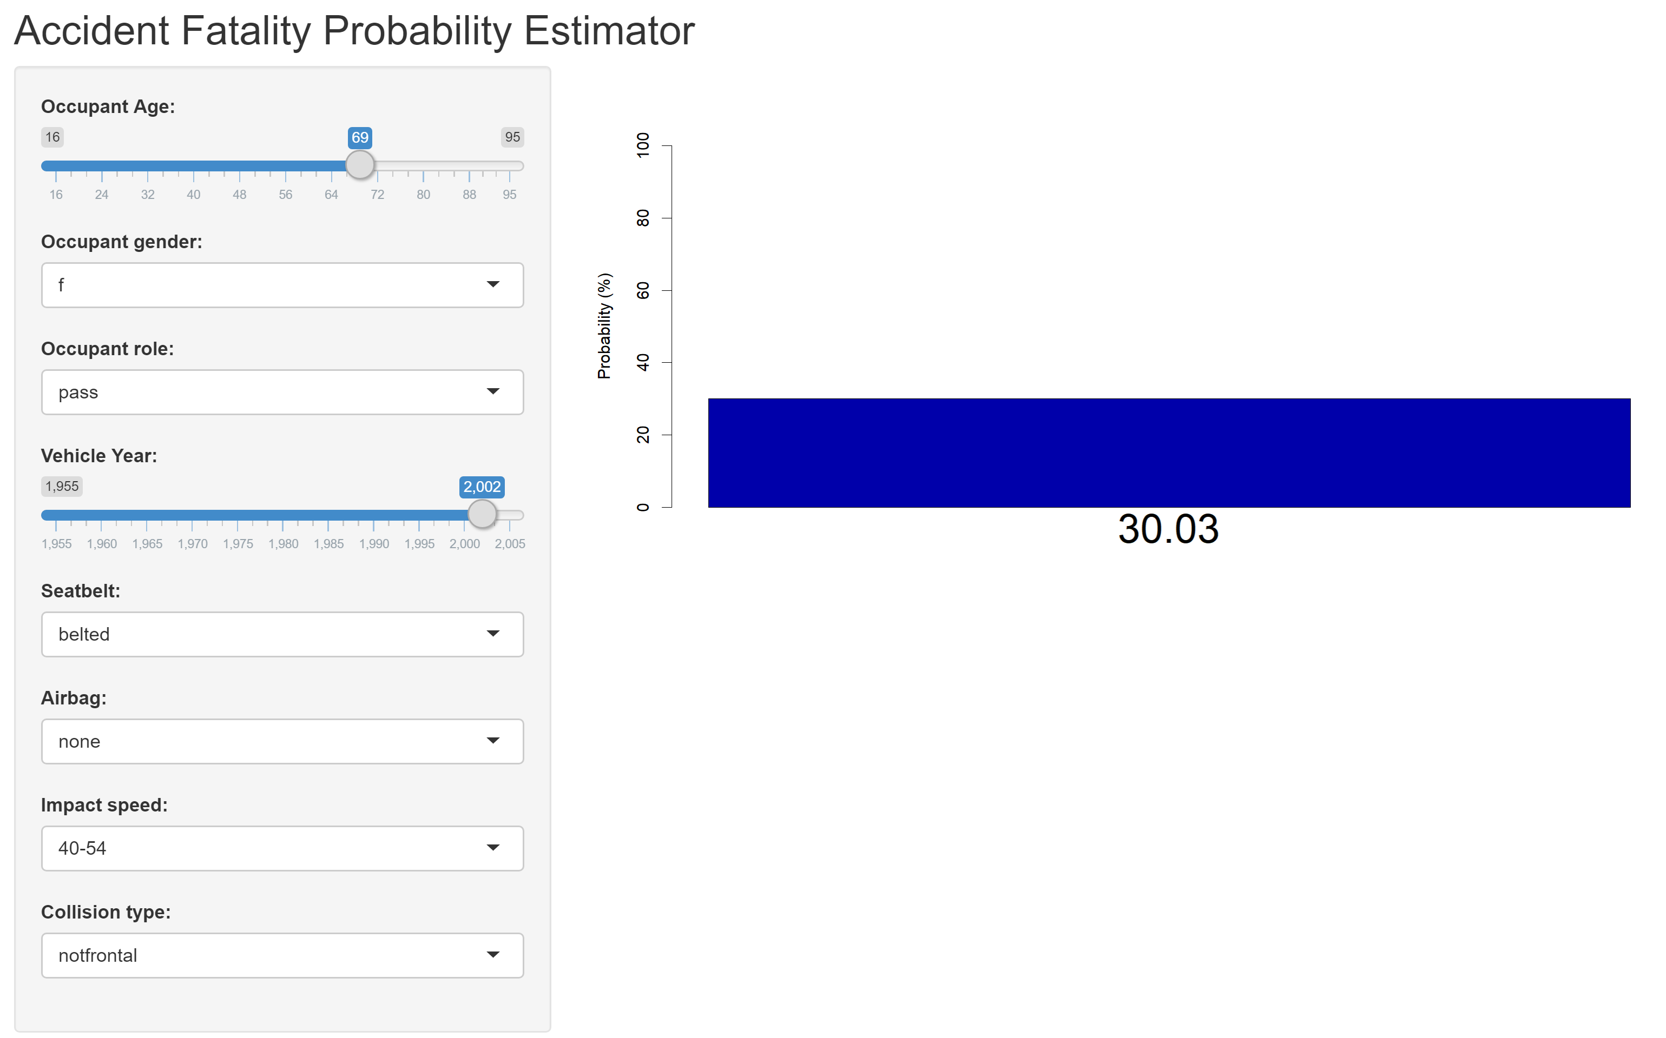

Slide 20
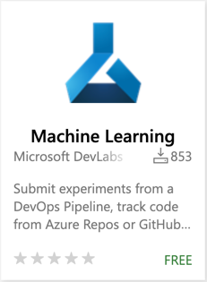


Pipelines
az extension add -n azure-cli-ml
Azure ML Pipelines
Azure Pipelines
in Azure DevOps
pip install --upgrade azureml-sdk
Notes:
Azure ML pipelines and Azure Piplelines work great together.
What’s the difference? Why use both?

Slide 21
Azure Pipelines in Azure DevOps
Orchestration for Continuous Integration and Continuous Delivery
Gates, tasks, and processes for quality
Integration with other services
Triggers on code and non-code events
Notes:
By contrast, Azure Pipelines are really designed for CI/CD
Gates… - They’re a great place to build in quality and checks and balances
Integration – with other applications, artifacts, and dependencies
Triggers – You way want to trigger orchestration for any number of reasons

Slide 22
Azure Machine Learning Pipelines
Workflows with of steps that can use Data Sources, Datasets, and Compute targets
Unattended runs
Reusability
Tracking and versioning of ML concepts
Notes:
ML Pipelines are designed for ML-specific workflows.
Unattended runs – ML training can be very long-running, and ML pipelines can handle that extremely well
Reusability – individual steps in a workflow can be resource intensive, and may not need to be run every time. If your data prep step doesn’t need to be run again, you can just reuse the output from last time.
Tracking… - Everything that’s stored is focused on ML, rather than building general software

Slide 23

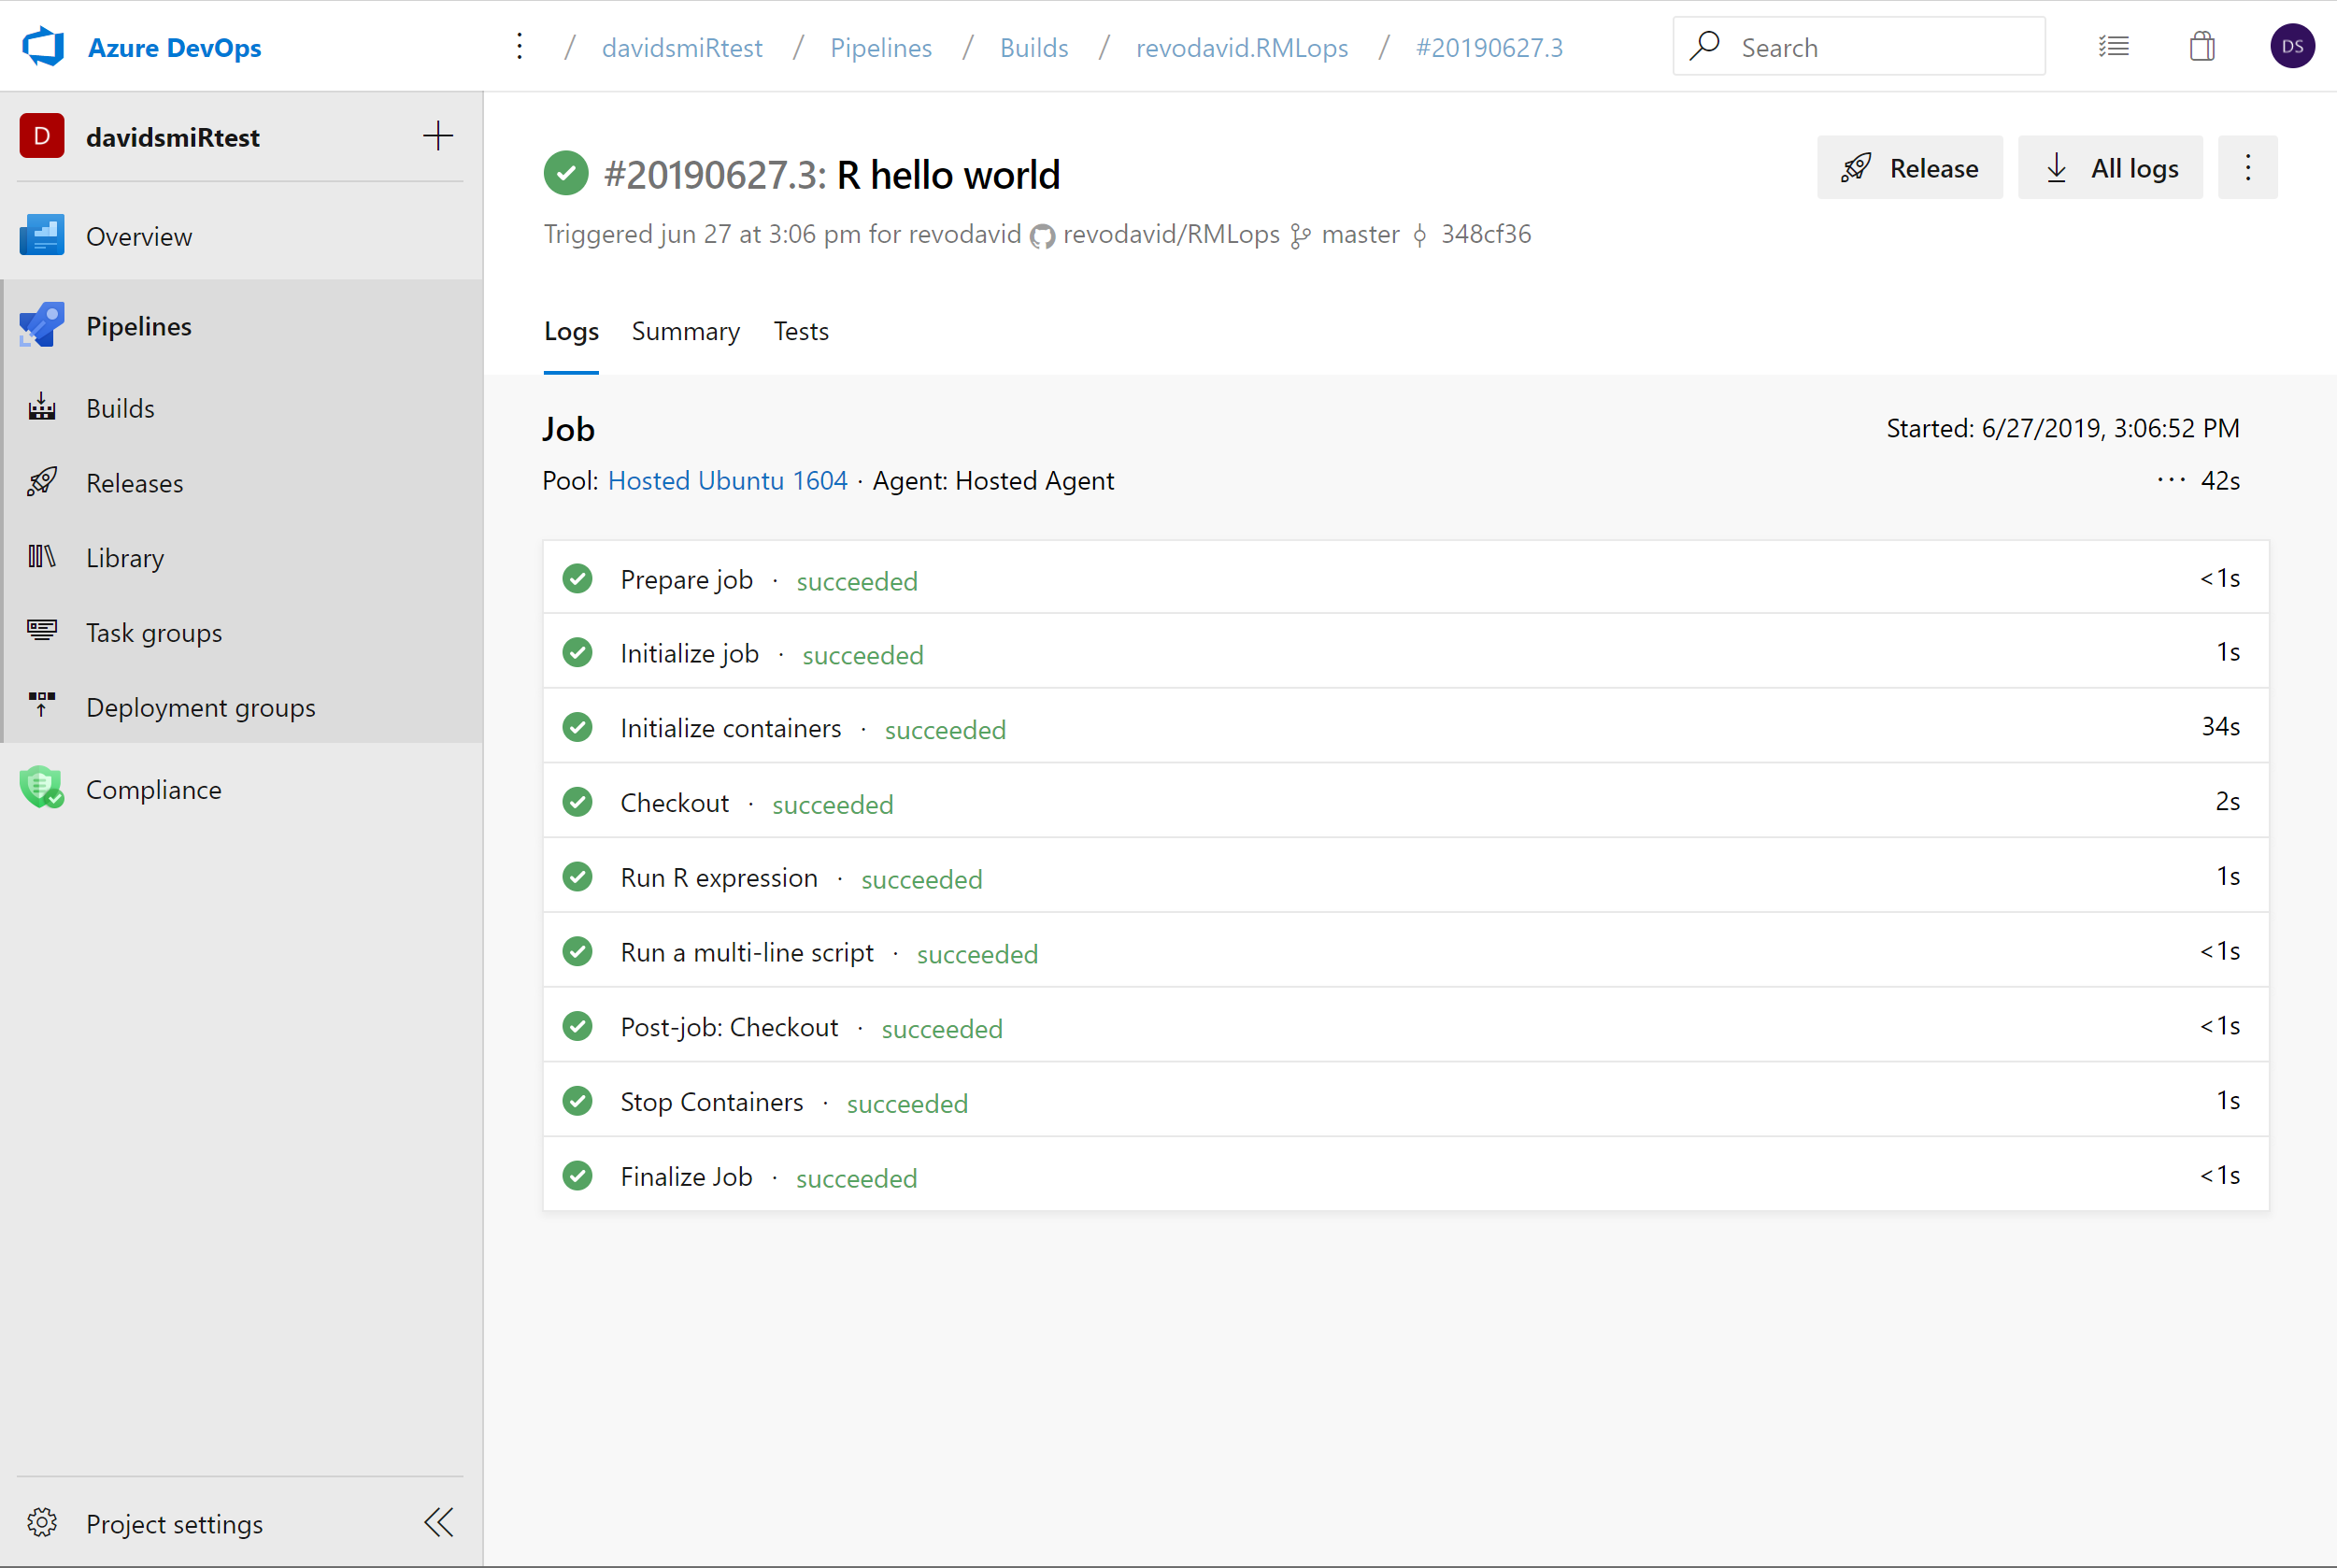
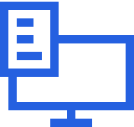

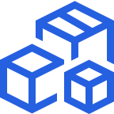

Pipelines in Azure DevOps
Cloud-hosted pipelines for Linux, Windows and macOS, with unlimited minutes for open source
Any language, any platform, any cloud
Build, test, and deploy Node.js, Python, Java, PHP, Ruby, C/C++, .NET, Android, and iOS apps. Run in parallel on Linux, macOS, and Windows. Deploy to Azure, AWS, GCP or on-premises
Extensible
Explore and implement a wide range of community-built build, test, and deployment tasks, along with hundreds of extensions from Slack to SonarCloud. Support for YAML, reporting and more
Containers and Kubernetes
Easily build and push images to container registries like Docker Hub and Azure Container Registry. Deploy containers to individual hosts or Kubernetes.
Best-in-class for open source
Ensure fast continuous integration/continuous delivery (CI/CD) pipelines for every open source project. Get unlimited build minutes for all open source projects with up to 10 free parallel jobs across Linux, macOS and Windows
➔
https://azure.com/pipelines
Notes:
Azure Pipelines is the perfect launchpad for your code – automating your builds and deployments so you spend less time with the nuts and bolts and more time being creative
Or: Github actions! Or Jenkins, or Travis. Same principles apply.

Slide 24
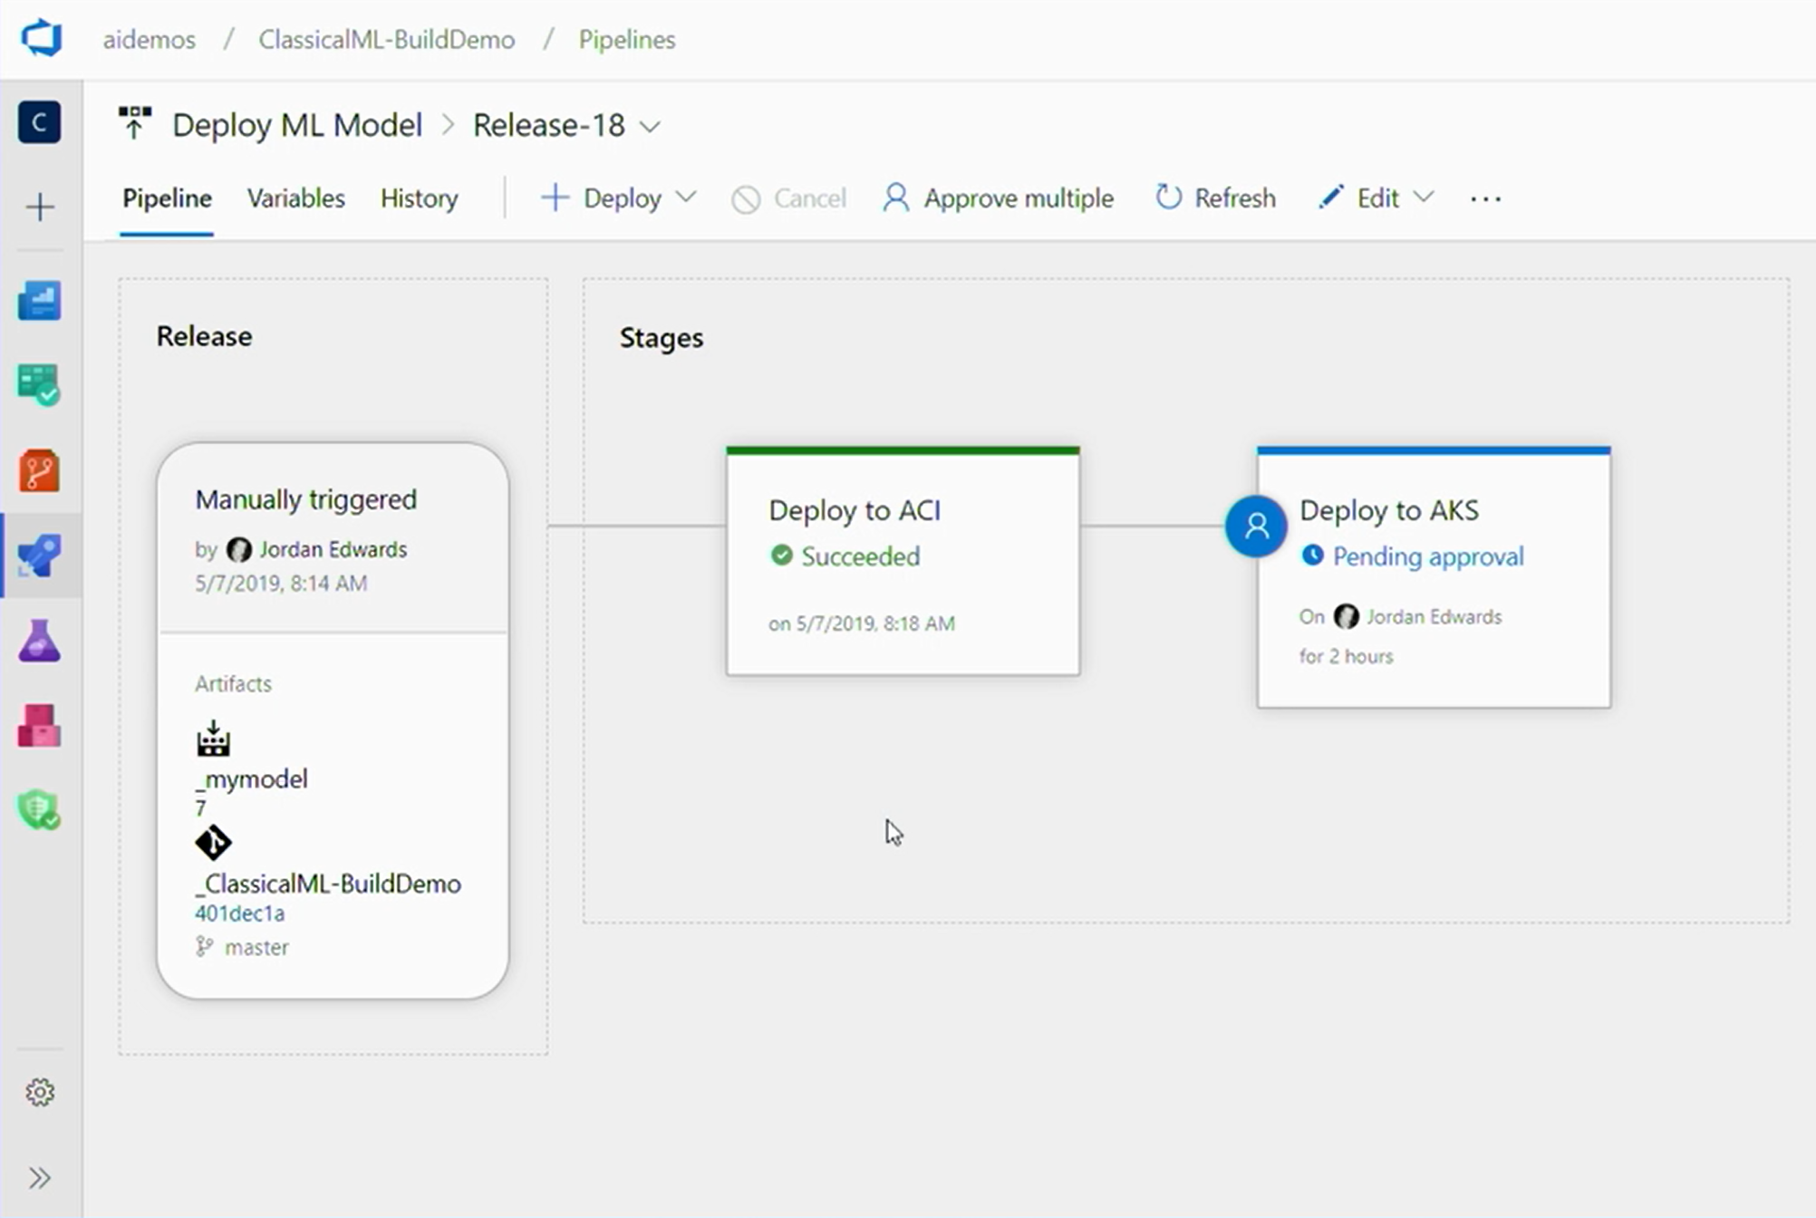
CI/CD for apps with Azure Pipelines
Azure ML extension triggers builds/releases on model registration in Azure ML Services
More details:
aka.ms/AIML50repo

Slide 25
Complete Pipeline
AML Pipeline
Data Preparation
Training
Model Registration
Azure DevOps Release Pipeline
Deployment to ACI
Deployment to AKS
Notes:
COMPLETE PIPELINE
Here’s what we’ve created:
A pipeline for training, which is an AML pipeline – specific to training our model
When we get a new model, we kick off a deployment pipeline in Azure DevOps
Deploy to ACI, run some tests, then if all is well, maybe deploy to AKS

Slide 26
Retraining
AML Pipeline
Data Preparation
Training
Model Registration
Azure DevOps Release Pipeline
Deployment to ACI
Deployment to AKS
Notes:
RETRAINING
Just like the rest of our software, we don’t want to put our model in production and leave it there, assuming it will always work.
So we need a retraining strategy.
Either periodically, or when the data is different enough in production that we’re not getting the results we want.
Azure ML Service has a solution for this

Slide 27


Azure Pipelines
Azure ML Service
➔
https://azure.com/pipelines
➔
https://azure.com/ml
Free unlimited build minutes for public projects
Up to 10 free parallel jobs across Windows, Linux and macOS
Free worskpaces, experiments, model registry
Standard Azure rates for compute and deployment or use your own servers for free
Notes:
All the builds you need, using the power of Azure you get one service that gives you unlimited build minutes where you can build on Windows Mac and Linux in parallel using a single build YAML file.

Slide 28
Thank you! David Smith Cloud Advocate, Microsoft @revodavid
Slides and links: aka.ms/mlops-r

Slide 29
MLOps for R with Azure Machine Learning (20 min)
Azure Machine Learning service (Azure ML) is Microsoft’s cloud-based machine learning platform that enables data scientists and their teams to carry out end-to-end machine learning workflows at scale. With Azure ML's new open-source R SDK and R capabilities, you can take advantage of the platform’s enterprise-grade features to train, tune, manage and deploy R-based machine learning models and applications.
In this talk, the attendees will learn how to:
•Carry out ML workflows using the authoring experience of their choice, from no-code to code-first options that include Azure ML’s drag-and-drop visual interface for defining workflows and RStudio Server on the Data Science Instance, a hosted VM workstation, for using the Azure ML R SDK from the RStudio browser-based interface.
•Use the Azure ML R SDK to manage cloud resources and train, hyperparameter tune, and log and visualize metrics for their models at scale on Azure compute.
•Build ML Pipelines in R for defining and orchestrating reusable and reproducible ML workflows.
•Deploy, manage, and monitor their R ML models and applications as web services on Azure Container Instance and Azure Kubernetes Service, with an emphasis on robust DevOps and CI/CD for orchestrating and streamlining their end-to-end data science development lifecycle.

